Slide 1
Blacktown Chinese Christian Church
Welcome to Our English Service 15.06.2025
English Service 9:45 – 11:00 am
Worship Songs: Passage: Speaker: Topic: Response Song: Announcements and Closing Prayer Benediction
Living hope Goodness of God Cornerstone Great is thy faithfulness 1 Kings 17:2-6, 18:19-24, 18:38-46, 2 Kings 2:7-16 Jenny Williams Elijah: God's Man TBA

Slide 2
BCCC english service

Slide 3

Please keep all phones on silent

Slide 4
Living Hope
Brian Johnson, Phil Wickham © 2017 Phil Wickham Music (Admin. by Crossroad Distributors Pty. Ltd.) Simply Global Songs (Admin. by Crossroad Distributors Pty. Ltd.) Sing My Songs (Admin. by Crossroad Distributors Pty. Ltd.) Bethel Music Publishing (Admin. by SHOUT! Music Publishing Australia) CCLI Licence No. 5485849. CCLI Song number: 7106807

Slide 5
How great the chasm that lay between us
How high the mountain I could not climb
In desperation, I turned to heaven
And spoke Your name into the night

Slide 6
Then through the darkness, Your loving kindness
Tore through the shadows of my soul
The work is ﬁnished, the end is written
Jesus Christ, my living hope

Slide 7
Who could imagine so great a mercy?
What heart could fathom such boundless grace?
The God of ages stepped down from glory
To wear my sin and bear my shame

Slide 8
The cross has spoken, I am forgiven
The King of Kings calls me His own
Beautiful Savior, I'm Yours forever
Jesus Christ, my living hope

Slide 9
Hallelujah, praise the One who set me free
Hallelujah, death has lost its grip on me

Slide 10
You have broken every chain
There's salvation in Your name
Jesus Christ, my living hope

Slide 11
Hallelujah, praise the One who set me free
Hallelujah, death has lost its grip on me

Slide 12
You have broken every chain
There's salvation in Your name
Jesus Christ, my living hope

Slide 13
Then came the morning that sealed the promise
Your buried body began to breathe
Out of the silence, the Roaring Lion
Declared the grave has no claim on me (x2)

Slide 14
Jesus, Yours is the victory

Slide 15
Hallelujah, praise the One who set me free
Hallelujah, death has lost its grip on me

Slide 16
You have broken every chain
There's salvation in Your name
Jesus Christ, my living hope

Slide 17
Hallelujah, praise the One who set me free
Hallelujah, death has lost its grip on me

Slide 18
You have broken every chain
There's salvation in Your name
Jesus Christ, my living hope

Slide 19
Jesus Christ, my living hope
Oh God, You are my living hope

Slide 20
Goodness Of God
Ben Fielding, Brian Johnson, Ed Cash, Jason Ingram, Jenn Johnson © Bethel Music Publishing (Admin. by SHOUT! Music Publishing Australia) CCLI Licence No. 5485849 . CCLI Song number: 7117726

Slide 21
I love You, Lord
For Your mercy never fails me
All my days, I've been held in Your hands

Slide 22
From the moment that I wake up
Until I lay my head
Oh, I will sing of the goodness of God

Slide 23
All my life You have been faithful
And all my life You have been so, so good
With every breath that I am able
Oh, I will sing of the goodness of God

Slide 24
I love Your voice
You have led me through the fire
And in darkest night You are close like no other

Slide 25
I've known You as a Father
I've known You as a Friend
And I have lived in the goodness of God

Slide 26
All my life You have been faithful
And all my life You have been so, so good
With every breath that I am able
Oh, I will sing of the goodness of God

Slide 27
Your goodness is running after, it's running after me
Your goodness is running after, it's running after me

Slide 28
With my life laid down, I'm surrendered now
I give You everything
Your goodness is running after, it's running after me

Slide 29
Your goodness is running after, it's running after me
Your goodness is running after, it's running after me

Slide 30
With my life laid down, I'm surrendered now
I give You everything
Your goodness is running after, it's running after me

Slide 31
All my life You have been faithful
And all my life You have been so, so good
With every breath that I am able
Oh, I'm gonna sing of the goodness of God

Slide 32
All my life You have been faithful
And all my life You have been so, so good
With every breath that I am able
Oh, I'm gonna sing of the goodness of God

Slide 33
Oh, I'm gonna sing of the goodness of God

Slide 34
Cornerstone
Edward Mote, Eric Liljero, Jonas Myrin, Reuben Morgan, William Batchelder Bradbury © 2011 Hillsong MP Songs (Admin. by Hillsong Music Publishing Australia) Hillsong Music Publishing UK (Admin. by Hillsong Music Publishing Australia) Hillsong Music Publishing Australia CCLI Licence No. 5485849 . CCLI Song number: 6158927

Slide 35
My hope is built on nothing less
Than Jesus blood and righteousness
I dare not trust the sweetest frame
But wholly trust in Jesus name (x2)

Slide 36
Christ alone, Cornerstone
Weak made strong in the Saviour's love
Through the storm, He is Lord
Lord of all

Slide 37
When darkness seems to hide His face
I rest on His unchanging grace

Slide 38
In every high and stormy gale
My anchor holds within the veil
My anchor holds within the veil

Slide 39
Christ alone, Cornerstone
Weak made strong in the Saviour's love
Through the storm, He is Lord
Lord of all

Slide 40
He is Lord, Lord of all

Slide 41
Christ alone, Cornerstone
Weak made strong in the Saviour's love
Through the storm, He is Lord
Lord of all

Slide 42
When He shall come with trumpet sound
Oh may I then in Him be found
Dressed in His righteousness alone
Faultless stand before the throne

Slide 43
Christ alone, Cornerstone
Weak made strong in the Saviour's love

Slide 44
Through the storm, He is Lord
Lord of all
He is Lord, Lord of all

Slide 45
Christ alone, Cornerstone
Weak made strong in the Saviour's love

Slide 46
Through the storm, He is Lord
Lord of all
He is Lord, Lord of all

Slide 47
Great Is Thy Faithfulness
Thomas Obediah Chisholm, William Marion Runyan ©Words: 1923. Renewed 1951 Hope Publishing Company Music: 1923. Renewed 1951 Hope Publishing Company CCLI Licence No. 5485849. CCLI Song number: 18723

Slide 48
Great is Thy faithfulness, O God my Father
There is no shadow of turning with Thee
Thou changest not, Thy compassions, they fail not
As Thou hast been, Thou forever will be

Slide 49
Great is Thy faithfulness, Great is Thy faithfulness
Morning by morning new mercies I see
All I have needed Thy hand hath provided
Great is Thy faithfulness, Lord, unto me

Slide 50
Summer and winter and springtime and harvest
Sun, moon and stars in their courses above
Join with all nature in manifold witness
To Thy great faithfulness, mercy and love

Slide 51
Great is Thy faithfulness
Great is Thy faithfulness
Morning by morning new mercies I see

Slide 52
All I have needed Thy hand hath provided
Great is Thy faithfulness, Lord, unto me

Slide 53
Pardon for sin and a peace that endureth
Thine own dear presence to cheer and to guide
Strength for today and bright hope for tomorrow
Blessings all mine, with ten thousand beside

Slide 54
Great is Thy faithfulness
Great is Thy faithfulness
Morning by morning new mercies I see

Slide 55
All I have needed Thy hand hath provided
Great is Thy faithfulness, Lord, unto me

Slide 56
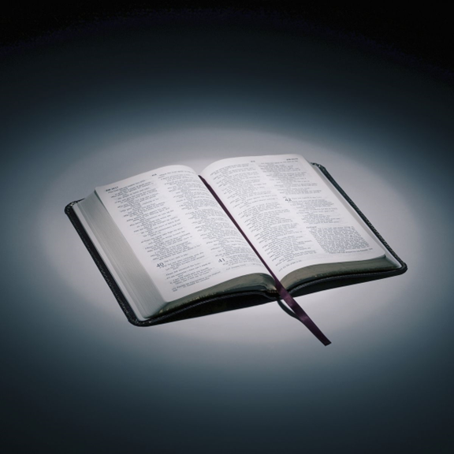
Bible reading

Slide 57
1 Kings 17:2-6, 18:19-24, 18:38-46, 2 Kings 2:7-16
² Then the word of the Lord came to Elijah: ³ “Leave here, turn eastward and hide in the Kerith Ravine, east of the Jordan.

Slide 58
1 Kings 17:2-6, 18:19-24, 18:38-46, 2 Kings 2:7-16
⁴ You will drink from the brook, and I have directed the ravens to supply you with food there.”
⁵ So he did what the Lord had told him. He went to the Kerith Ravine, east of the Jordan, and stayed there.

Slide 59
1 Kings 17:2-6, 18:19-24, 18:38-46, 2 Kings 2:7-16
⁶ The ravens brought him bread and meat in the morning and bread and meat in the evening, and he drank from the brook.
¹⁹ Now summon the people from all over Israel to meet me on Mount Carmel. And bring the four hundred and fifty prophets of Baal and the four hundred prophets of Asherah, who eat at Jezebel’s table.”

Slide 60
1 Kings 17:2-6, 18:19-24, 18:38-46, 2 Kings 2:7-16
²⁰ So Ahab sent word throughout all Israel and assembled the prophets on Mount Carmel. ²¹ Elijah went before the people and said, “How long will you waver between two opinions? If the Lord is God, follow him; but if Baal is God, follow him.”
But the people said nothing.

Slide 61
1 Kings 17:2-6, 18:19-24, 18:38-46, 2 Kings 2:7-16
²² Then Elijah said to them, “I am the only one of the Lord’s prophets left, but Baal has four hundred and fifty prophets. ²³ Get two bulls for us. Let Baal’s prophets choose one for themselves, and let them cut it into pieces and put it on the wood but not set fire to it. I will prepare the other bull and put it on the wood but not set fire to it.

Slide 62
1 Kings 17:2-6, 18:19-24, 18:38-46, 2 Kings 2:7-16
²⁴ Then you call on the name of your god, and I will call on the name of the Lord. The god who answers by fire—he is God.”
Then all the people said, “What you say is good.”
³⁸ Then the fire of the Lord fell and burned up the sacrifice, the wood, the stones and the soil, and also licked up the water in the trench.

Slide 63
1 Kings 17:2-6, 18:19-24, 18:38-46, 2 Kings 2:7-16
³⁹ When all the people saw this, they fell prostrate and cried, “The Lord—he is God! The Lord—he is God!”
⁴⁰ Then Elijah commanded them, “Seize the prophets of Baal. Don’t let anyone get away!” They seized them, and Elijah had them brought down to the Kishon Valley and slaughtered there.

Slide 64
1 Kings 17:2-6, 18:19-24, 18:38-46, 2 Kings 2:7-16
⁴¹ And Elijah said to Ahab, “Go, eat and drink, for there is the sound of a heavy rain.” ⁴² So Ahab went off to eat and drink, but Elijah climbed to the top of Carmel, bent down to the ground and put his face between his knees.

Slide 65
1 Kings 17:2-6, 18:19-24, 18:38-46, 2 Kings 2:7-16
⁴³ “Go and look toward the sea,” he told his servant. And he went up and looked.
“There is nothing there,” he said.
Seven times Elijah said, “Go back.”
⁴⁴ The seventh time the servant reported, “A cloud as small as a man’s hand is rising from the sea.”
So Elijah said, “Go and tell Ahab, ‘Hitch up your chariot and go down before the rain stops you.’”

Slide 66
1 Kings 17:2-6, 18:19-24, 18:38-46, 2 Kings 2:7-16
⁴⁵ Meanwhile, the sky grew black with clouds, the wind rose, a heavy rain started falling and Ahab rode off to Jezreel. ⁴⁶ The power of the Lord came on Elijah and, tucking his cloak into his belt, he ran ahead of Ahab all the way to Jezreel.

Slide 67
1 Kings 17:2-6, 18:19-24, 18:38-46, 2 Kings 2:7-16
⁷ Fifty men from the company of the prophets went and stood at a distance, facing the place where Elijah and Elisha had stopped at the Jordan. ⁸ Elijah took his cloak, rolled it up and struck the water with it. The water divided to the right and to the left, and the two of them crossed over on dry ground.

Slide 68
1 Kings 17:2-6, 18:19-24, 18:38-46, 2 Kings 2:7-16
⁹ When they had crossed, Elijah said to Elisha, “Tell me, what can I do for you before I am taken from you?”
“Let me inherit a double portion of your spirit,” Elisha replied.
¹⁰ “You have asked a difficult thing,” Elijah said, “yet if you see me when I am taken from you, it will be yours—otherwise, it will not.”

Slide 69
1 Kings 17:2-6, 18:19-24, 18:38-46, 2 Kings 2:7-16
¹¹ As they were walking along and talking together, suddenly a chariot of fire and horses of fire appeared and separated the two of them, and Elijah went up to heaven in a whirlwind. ¹² Elisha saw this and cried out, “My father! My father! The chariots and horsemen of Israel!” And Elisha saw him no more. Then he took hold of his garment and tore it in two.

Slide 70
1 Kings 17:2-6, 18:19-24, 18:38-46, 2 Kings 2:7-16
¹³ Elisha then picked up Elijah’s cloak that had fallen from him and went back and stood on the bank of the Jordan. ¹⁴ He took the cloak that had fallen from Elijah and struck the water with it. “Where now is the Lord, the God of Elijah?” he asked. When he struck the water, it divided to the right and to the left, and he crossed over.

Slide 71
1 Kings 17:2-6, 18:19-24, 18:38-46, 2 Kings 2:7-16
¹⁵ The company of the prophets from Jericho, who were watching, said, “The spirit of Elijah is resting on Elisha.” And they went to meet him and bowed to the ground before him. ¹⁶ “Look,” they said, “we your servants have fifty able men. Let them go and look for your master. Perhaps the Spirit of the Lord has picked him up and set him down on some mountain or in some valley.”
“No,” Elisha replied, “do not send them.”

Slide 72
Announcements

Slide 73





Account name: Blacktown Chinese Christian Church
Account number: 4216 50263
Offering
BSB: 112 - 879
Please put in "offering" as the reference
The offering box is available at the back of the hall

Slide 74
Prayer points

Slide 75
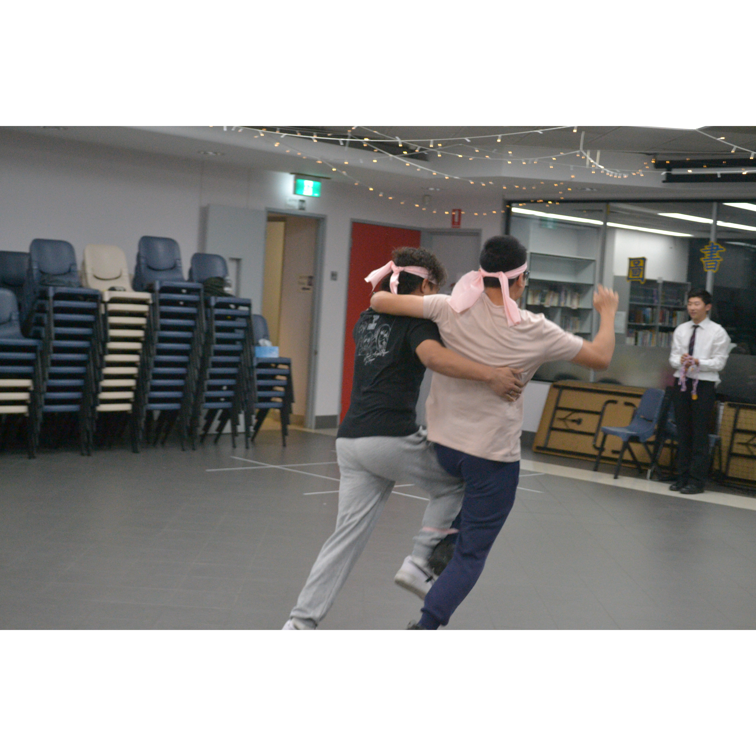
Mingle time!

